Slide 1
Project Tools

Slide 2
Content
Agile
Version Control System
Why
What
How

Slide 3
AGILE
set of exciting new practices and techniques that make product development:
Cyclical
Incremental
born out of the techniques utilized by innovative Japanese companies in the 70’s and 80’s (companies like Toyota, Fuji, and Honda).

Slide 4
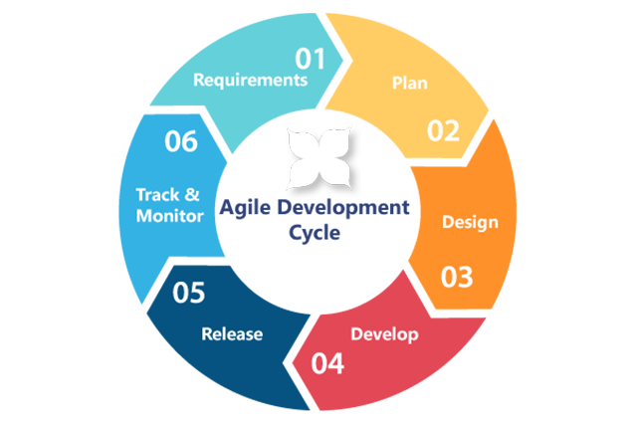
AGILE

Slide 5
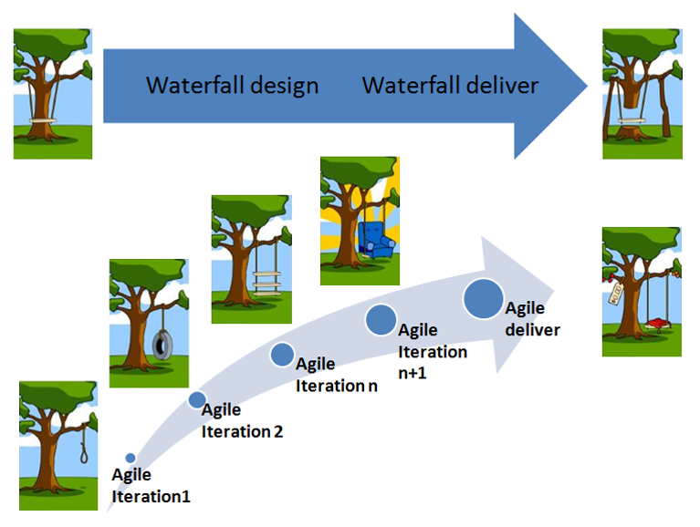
AGILE

Slide 6
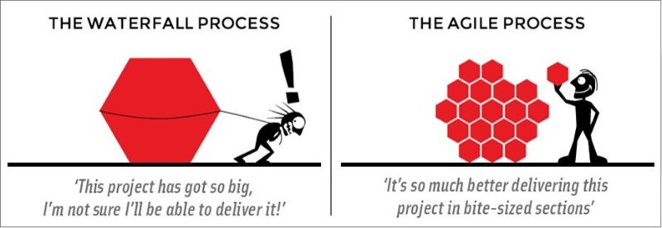
AGILE

Slide 7
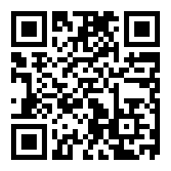
TOOLS
Trello

Slide 8
Version Control System
software tools that help a software team manage changes to source code over time
keeps track of every modification to the code
if a mistake is made, developers can turn back the clock and compare earlier versions of the code to help fix the mistake while minimizing disruption to all team members

Slide 9
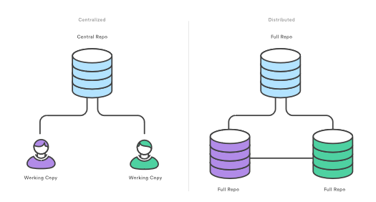
GIT
Notes:
- ex: nu exista internet, dar calculatoarele fac parte din aceeasi retea

Slide 10
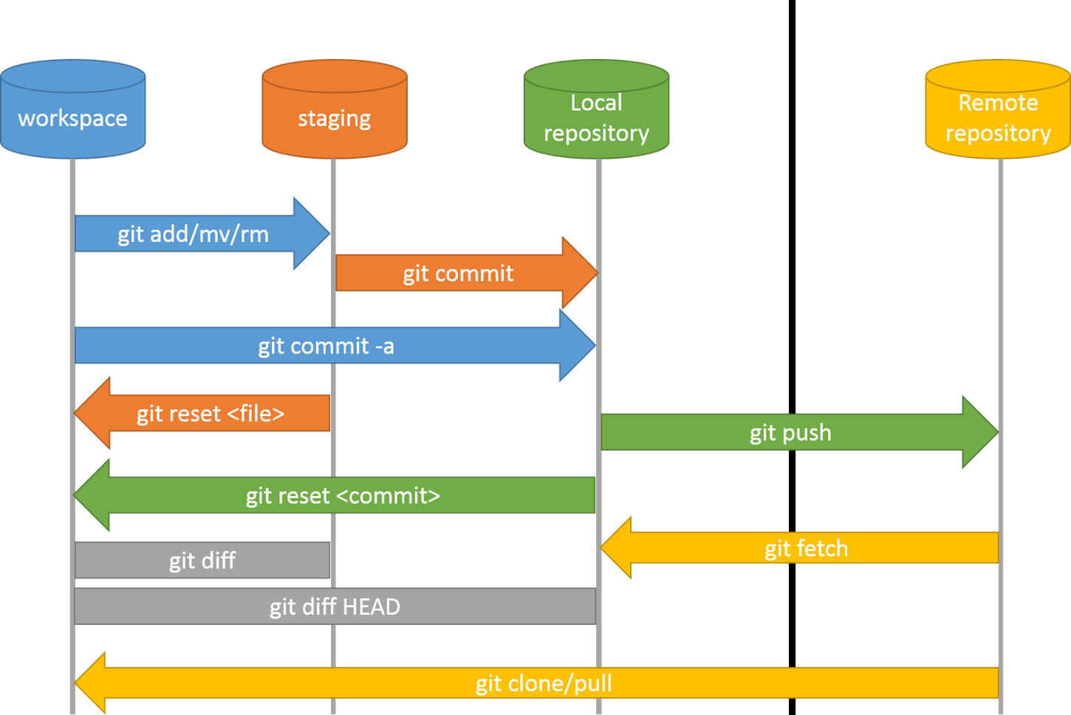
GIT - Commands

Slide 11
GITHUB
Create account
Create first repository
Clone repository
Add a file
Commit changes
Push changes

Slide 12
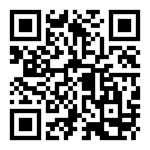
GITHUB project

Slide 13

One Common Goal

